Slide 1





Asymmetric Cascaded H-bridge Multilevel Inverter: Advantages and Challenges
Prof. Dr. Tiago Davi Curi Busarello
July, 20th - 2020

Slide 2

Agenda
Asymmetric Cascaded H-Bridge Multilevel Inverter Topology (from now on: asymmetric inverter)
Staircase modulation (Why not PWM?)
Power Distribution
DC-link currents
Closed-Loop current control (grid-connected)
Closed-Loop voltage control (isolated)
Applications and Challenges
Conclusions
Q&A
July, 20th - 2020

Slide 3
Topology (Power Structure)
12 transistors
3 H-bridge converters. Series connection of their outputs
Unequal DC sources
DC sources scaled in the ratio {1:2:6} or {1:3:9}
Modules: Upper, central and lower modules
Three modules. Why not 2 or 4 or more? (Answer in the next slides)
July, 20th - 2020

Slide 4
Staircase Modulation
Comparisons: Reference is compared with DC values
July, 20th - 2020

Slide 5
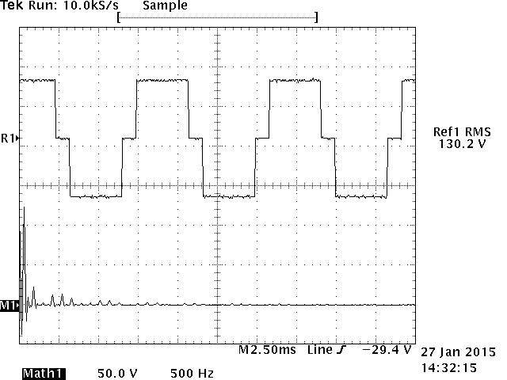
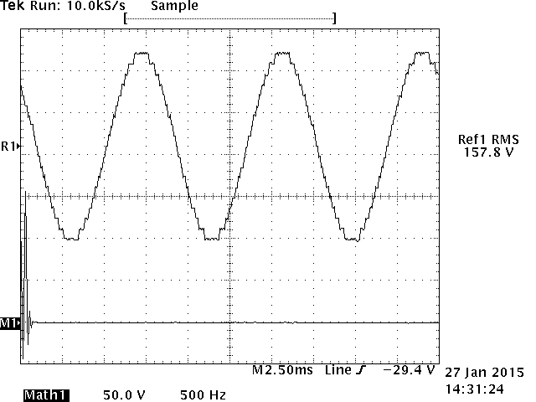
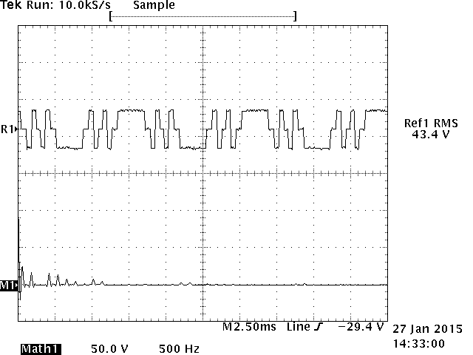
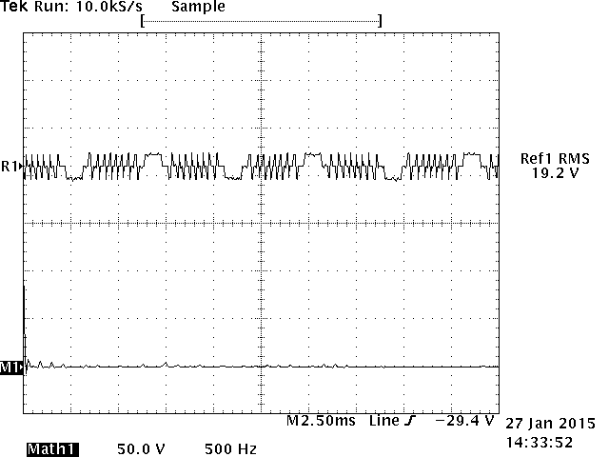
Staircase Modulation
{1:2:6} 19 levels
{1:3:9} 27 levels
Very close to sinusoidal
Low filtering requirements
Question? Why not 2, 4 or more modules?
A: 4 or more: Unnecessary.
2 better using other modulation
July, 20th - 2020

Slide 6
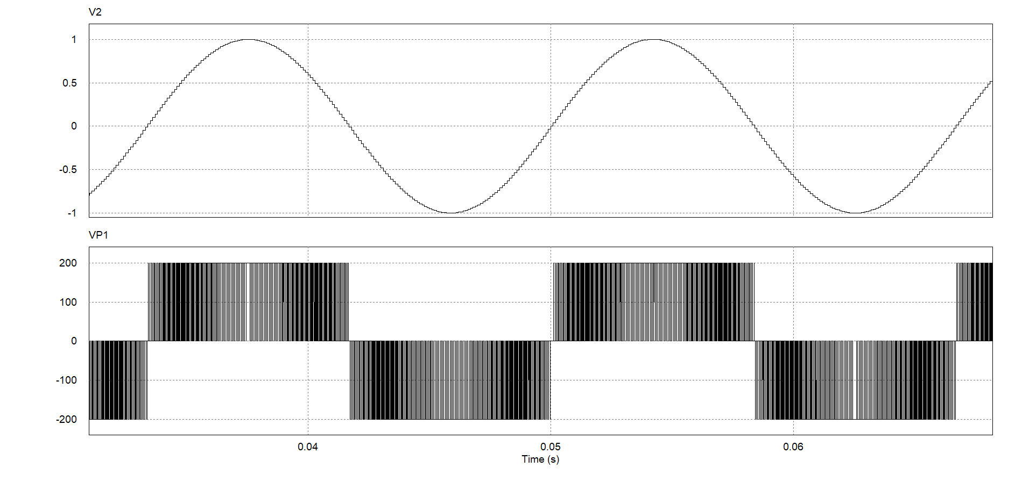
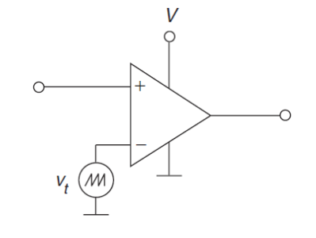
Staircase Modulation
Why not to use PWM?
Background
fsw = 20 kHz
Thousands of commutations within 1 cycle
Switching losses
July, 20th - 2020

Slide 7
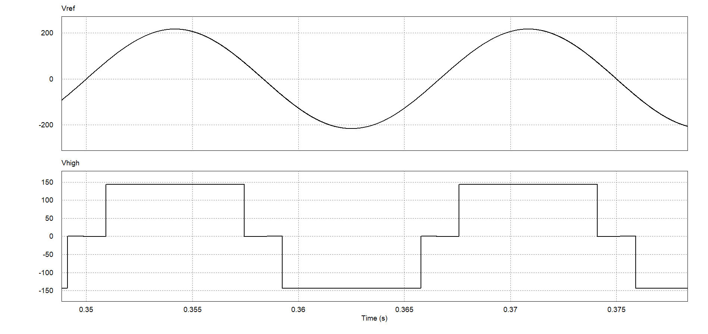
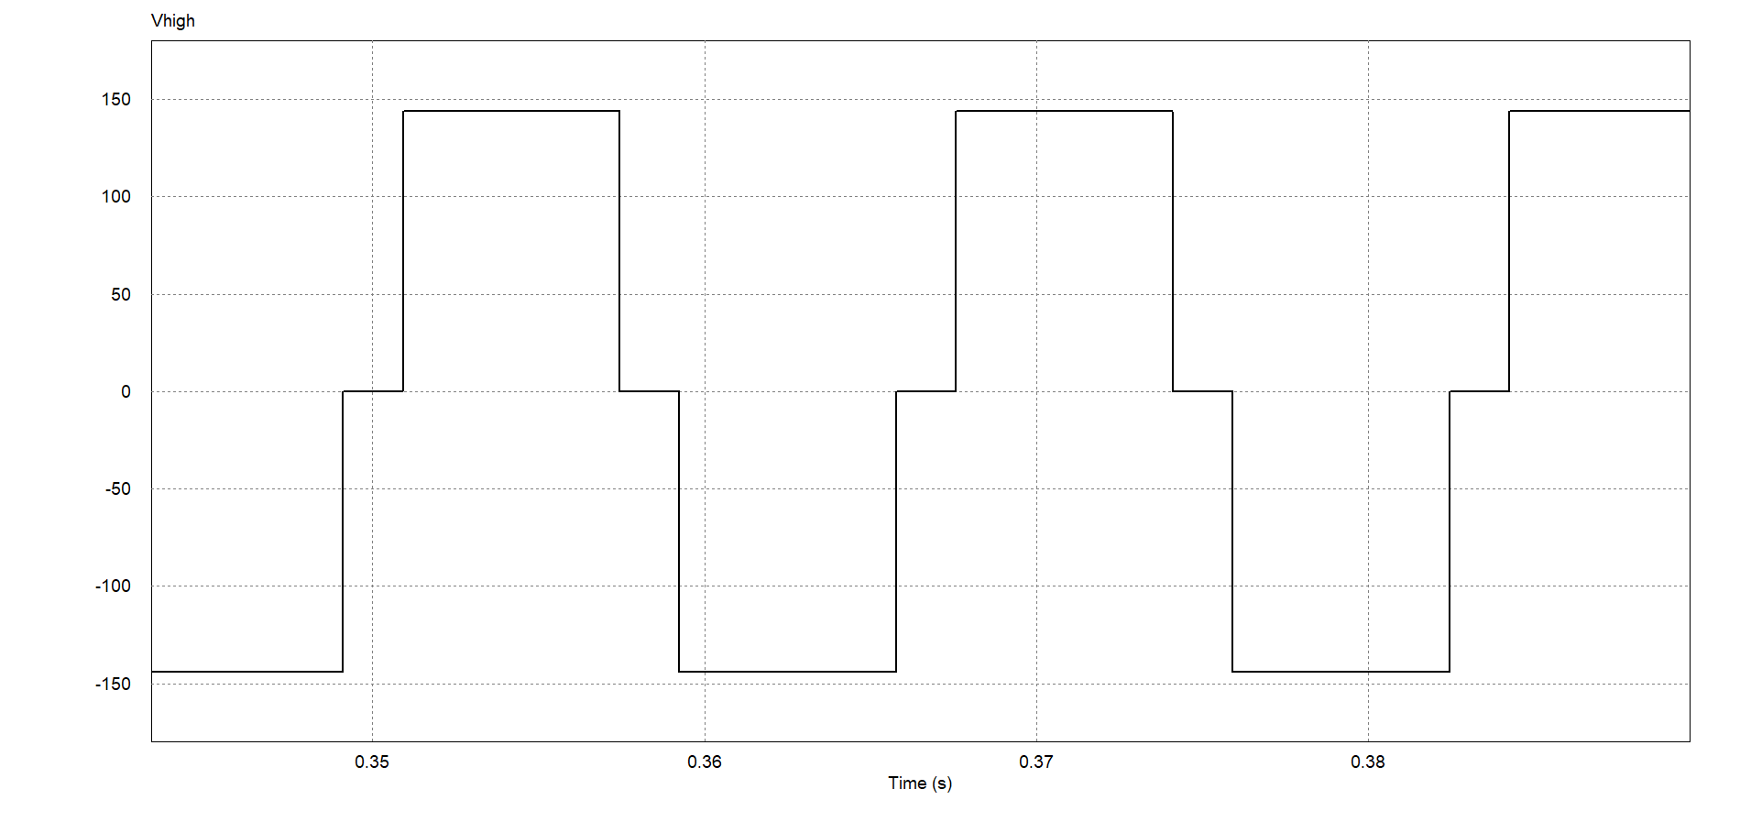
Staircase Modulation
Why not to use PWM?
Pref
Few commutations within 1 cycle
Switching frequency of the upper module is 50 or 60Hz (low losses)
The upper module may hold 80% of the total processing power.
Low filtering requirements
Main advantages of using this topology
Central and Lower modules also have few commutations
Answer: PWM loses the advantages of the asymmetric topology
Actually, any modification in the topology probably makes it unfeasible.
July, 20th - 2020

Slide 8
Power Distribution
Pref
July, 20th - 2020

Slide 9



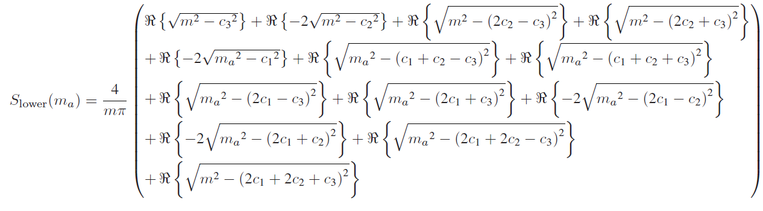
Power Distribution
It is dependent on the switching function (modulation index)
Nonlinear (this is the main drawback of the asymmetric topology)
T. D. C. Busarello, A. L. de Sousa Marcondes Reuter, A. Péres and M. G. Simões, "Understanding the Staircase Modulation Strategy and Its Application in Both Isolated and Grid-Connected Asymmetric Cascaded H-Bridge Multilevel Inverters," in IEEE Transactions on Industry Applications, vol. 55, no. 5, pp. 5371-5382, Sept.-Oct. 2019, doi: 10.1109/TIA.2019.2927189.
July, 20th - 2020

Slide 10
Power Distribution
For m = 1, the upper module processes 80% of the total power in {1:2:6} and 83% in {1:3:9}.
There are moments when the processed power is negative in the central and lower modules, called regenerative power.
It indicates power consumption from a module while the inverter is intended to supply, resulting in a contradiction.
The range where the three modules process positive power simultaneously (without applying any solution) is very limited.
For the {1:2:6}, the range comprises the modulation index from 0.94 to 1. In {1:3:9}, from 0.96 to 1. There is also a short range also around m = 0.77 for the {1:2:6} and around m = 0.82 for {1:3:9}.
The lower modules processes at most 4.2% of total power in {1:2:6} and 3.2% in {1:3:9}. Processing lower power allows the lower module be modified without compromising the whole operation.
July, 20th - 2020

Slide 11
Power Distribution
BMS may be prepared for that
Limitations in the modulation index
In case of capacitors instead of DC sources, controlling DC-link voltage is a challenge
Drawbacks of this topology
July, 20th - 2020

Slide 12
DC-link currents
July, 20th - 2020

Slide 13
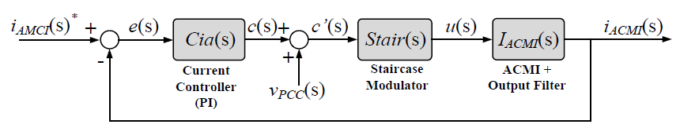
Closed-loop Current Control (grid)
The system is nonlinear
Can be linearized for an operation point
Modulation index within 0.94 to 1
Linear controller
System has low bandwidth
July, 20th - 2020

Slide 14
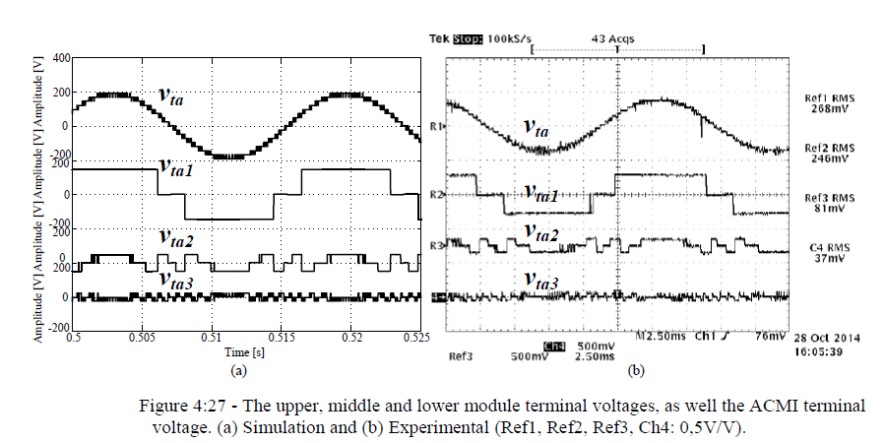
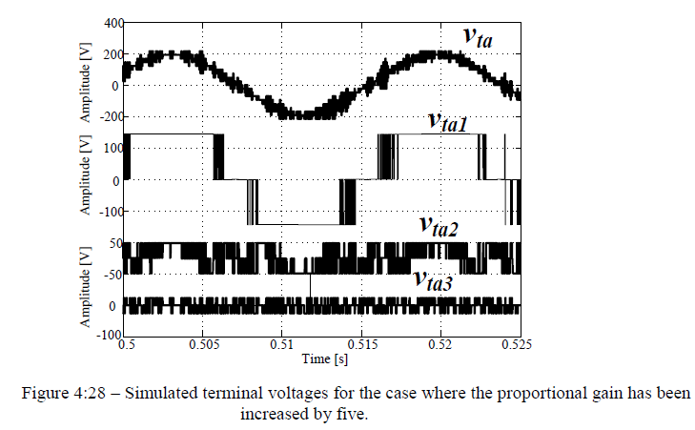
Closed-loop Current Control
Influence of the proportional gain. Cannot be very high
July, 20th - 2020

Slide 15
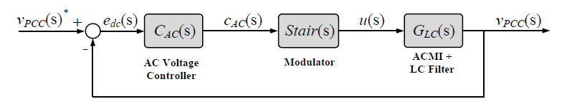
Closed-loop Voltage Control (isolated)
Modify the output filter
Two types of controller: PR and Cascaded PI (two loops)
T. D. C. Busarello, A. Mortezaei, H. K. M. Paredes, A. Al-Durra, J. A. Pomilio and M. G. Simões, "Simplified Small-Signal Model for Output Voltage Control of Asymmetric Cascaded H-Bridge Multilevel Inverter," in IEEE Transactions on Power Electronics, vol. 33, no. 4, pp. 3509-3519, April 2018, doi: 10.1109/TPEL.2017.2704919.
July, 20th - 2020

Slide 16
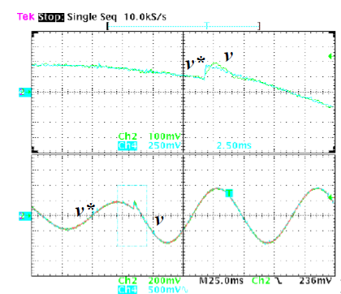
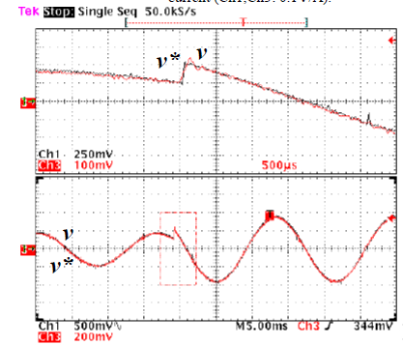
Closed-loop Voltage Control
T. D. C. Busarello, A. Mortezaei, H. K. M. Paredes, A. Al-Durra, J. A. Pomilio and M. G. Simões, "Simplified Small-Signal Model for Output Voltage Control of Asymmetric Cascaded H-Bridge Multilevel Inverter," in IEEE Transactions on Power Electronics, vol. 33, no. 4, pp. 3509-3519, April 2018, doi: 10.1109/TPEL.2017.2704919.
July, 20th - 2020

Slide 17
Applications and Challenges
+
  Operation within 0.94 to 1.
  Handle bulk power
  Medium voltage industrial grid.
  Battery-based storage (efficiency) (Fuel cells)
  STATCOM (capacitor instead of DC-source. Not hard to control the DC-link voltages)
  Motor Driver (no filter)
-
  Applications that need to a large range of modulation index
  Active filter (hard to control the DC-link voltages. Low harmonic orders comp.)
  PV systems (not trivial for MPPT. Not allowed the inclusion of DC-DC converter)
  WG systems.
July, 20th - 2020

Slide 18
Conclusions
The main advantage of the asymmetric multilevel inverter is the upper module
It switches at 50Hz (or 60)
It processes 80% of the total power
The topology needs no high order and high volume filters
Power distribution among the modules is nonlinear (main drawback)
Topology and modulation should be kept unchanged
Any modification in the structure or in the modulation may be investigated
The drawbacks may overlap the advantages
Not the first option
It needs nonlinear control strategies
July, 20th - 2020

Slide 19

Acknowledgements
Prof. Dr. Janamejaya Channegowda
July, 20th - 2020

Slide 20

Thank you!
Questions?
Contact
tiago.busarello@gmail.com
http://busarello.prof.ufsc.br
Youtube: Tiago Davi Curi Busarelo
July, 20th - 2020

